Slide 1






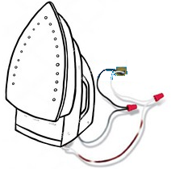

Data Standardization to OMOP Enables Systematic Research
Traditional way
OHDSI approach
Analytical method: Adherence to Drug
North America
China
North America Southeast Asia China
Southeast Asia
OMOP CDM
Europe
UK
Japan
India
Europe UK Japan India
So Africa
Switzerland
Italy
Israel
So Africa Switzerland Italy Israel
Adherence
Mortality
Prediction
One SAS or R script for each study
Not scalable
Not transparent
Expensive
Slow
Prohibitive to non-expert routine use
OHDSI Tools
Safety Signals

Slide 2
Cancer Research is different from other diseases
It needs more detail:
“What is the overall survival for patients with non-metastatic carcinoma of the neck of bladder in remission after first line of gemcitabin-containing chemotherapy?“
Concepts in this research question currently not standardized:
Concept | Category
Carcinoma | Histology
Neck of bladder | Anatomical site
Non-metastatic disease | Tumor attribute
Disease in remission | Condition Episode
First line treatment | Treatment Episode
Chemotherapy regimen | Regimen
Gemcitabin | Component of regimen

Slide 3
Five Goals
Build standards on top of OMOP
Vocabularies Oncology Module
Data model
Create algorithms and heuristics
Infer Disease Episodes (automatic abstraction)
Infer chemo regimens
Build network of data nodes
Build network of researchers
Do research

Slide 4
Working Group Detail
Participants
OHDSI
Ajou University
AstraZeneca
Center for Surgical Science, Region Sjaelland
Children’s Hospital of Pennsylvania
Columbia University
Digital China Health
Integraal Kankercentrum Nederland
IQVIA
Memorial Sloan Kettering Cancer Center
Merck
Montefiore
Mount Sinai
Multiple Myeloma Foundation
NIH
Northwestern University
Odysseus
Oncology Analytics
Pittsburgh University
Providence Health
Vanderbilt
Subgroups
Leadership
Outreach/Research
Development
CDM/Vocabulary
Genomic
Vocabularies implemented/under Consideration
ICD-O-3
NAACCR
CAP
IMO
HemOnc
OROT

Slide 5
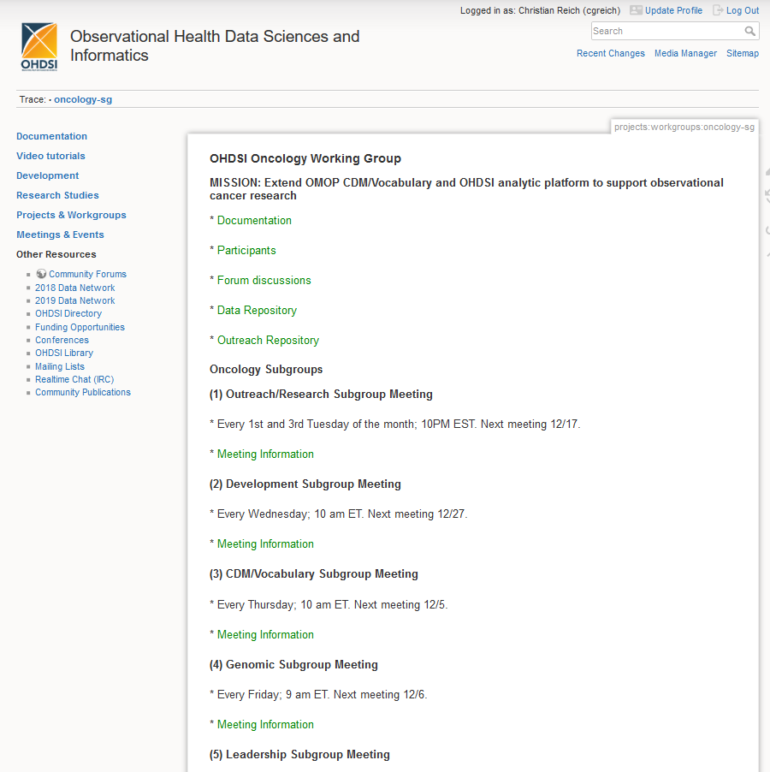

Slide 6
Use Cases
Survival
Overall
Disease-free
Symptom-free
From diagnosis
From treatment
Time
From diagnosis to treatment
From screening to diagnosis
From symptoms/initial primary care visit to diagnosis
Variations in outcomes of bladder cancer with and w/o liver metastases
Define uptake of genomic test
Identify treatment regimens
Compare tumor registry chemo with identified chemo regimens
Validate identified chemo regimens against Beacon
Compare uptake of newer medications vs. older medications
Number of medications taken daily by a cancer patient
Speed of drug administrations and the risk of allergic reaction/rejection
Time of administration
Comparative effectiveness of adhering to the administration rules vs deviations
Metastatic hormone–sensitive prostate cancer and non-metastatic castration-resistant pros

